Slide 1
Introduction to OrganiZational Behavior
MODULE 2

Slide 2
Organizational behavior
Organizational Behavior (OB) is the systematic study of how individuals and groups act within organizations.
It is:
Interdisciplinary - OB draws upon knowledge from behavioral sciences, including psychology (individual behavior), sociology (group dynamics), and anthropology (organizational culture).
Human centric and Technical - It balances human needs (satisfaction, growth) with technical requirements (productivity, efficiency).
Scientific Approach - It applies a systematic, research-oriented approach to manage human resources rather than relying on common sense.
Action-oriented - The goal is to apply knowledge for better performance, leadership, and managing change

Slide 3
Definitions
LM Prasad defined organizational behavior “it is the study of human knowledge related to elements of an organization such as internal and external environment or social system, superior in technology and their flexibility to fit in the organization”
According to Stephen P Robins “it is a systematic study within organization which is used to exhibit people attitude and their actions towards the work.”
Robbins further elaborated his definition by saying “it studies the impact on behavior of an individual or groups of individuals within the organization for the purpose to use the knowledge for the improvement of an organizational effectiveness.”

Slide 4
definitions
According to Clark “Organizational behavior study means how an individual or a group of individual act in the organization”
Davis has defined organizational behavior as the overall study of human behavior, structure of organization and their key elements i.e. technology, environment and shape.
Luthans defines “OB is the combination of total interaction and their interdependency between both of them”
After concluding all the definitions, it can be said that that OB covers all three areas of:
human behavior in the organization
individuals, group of individuals and
organization as a whole

Slide 5
Nature of ob
A Separate Field of Study and Not a Discipline Only
An Interdisciplinary Approach
An Applied Science -it uses theories, concepts, and principles from different disciplines to solve practical problems in organizations
A Normative Science – how employees should and how organization must ought
A Humanistic and Optimistic Approach - It deals with the thinking and feeling of human beings.
A Total System Approach -The system approach is one that integrates all the variables, affecting organizational functioning

Slide 6
Scope of ob
Impact of culture on organizational behavior
Management of change
Management of conflict and stress
Organizational development
Organizational culture
Transactional analysis
Group behaviours, power and politics
Job design
Study of emotions
Impact of personality on performance
Employee motivation
Leadership
How to create effective teams and groups
Study of different organizational structures
Individual behaviours, attitude and learning
Perception
Design and development of effective organization
Job design

Slide 7
Objectives of ob
(i) To analyse different perspective and potentialities to create and develop the ethical values in an organisation,
(ii) To analyse the potentialities towards the ways and means to conduct and organise the systems, methods and approaches for organisation development in an organisation,
(iii) To analyse the potentialities to develop process, methods and approaches of formal and informal patterns of organisation and society,
(iv) To analyse how to make perspective methods and process of effective communication to formulate ethical norms in an organisation,
(v) To analyse various aspects and factors affecting the group cohesiveness

Slide 8
Objectives of ob
(vi) To analyse the ways and means to develop different ethical aspects for group dynamism,
(vii) To analyse the mutual interest of individual and group. Mutual interest is represented by the statement ‘Organisation needs people, and people also need organisation’,
(viii) To analyse and evaluate the role of different key elements like people, structure, technology interactive behaviour and environment etc.
(ix) To analyse and evaluate the behavioural approaches in organisation. In context of that all of them are based on ‘Art’ and ‘Science’,

Slide 9
Importance of ob
Creates Sustainable Competitive Advantage – Ex. Lata Mangeshkar
Individual Component – Introvert person (psychometric test)
Group/Team Component – Two groups with varied performance
Organisational Component - Hartals
Leadership Component
External Forces Component

Slide 10
Three Basic Units of Analysis of OB
Organizational Behavior studies behavior in organizations at three main levels or units of analysis.
These levels help managers understand how individuals and groups behave within an organization.

Slide 11
Three Basic Units of Analysis of OB
1. Individual Level
This level focuses on the behavior of individual employees in the organization. It studies how personal factors influence performance and behavior.
Key aspects include:
Personality
Attitudes
Perception
Motivation
Learning
Understanding individual behavior helps managers improve job satisfaction, productivity, and employee development.

Slide 12
Three Basic Units of Analysis of OB
2. Group Level
This level studies the behavior of people working in groups or teams. Since most organizational tasks are performed collectively, understanding group dynamics is important.
Key aspects include:
Teamwork
Leadership
Communication
Group norms
Conflict management
Studying group behavior helps organizations build effective teams and improve coordination among employees.

Slide 13
Three Basic Units of Analysis of OB
3. Organizational Level
This level examines the organization as a whole system. It focuses on how structure, culture, and policies influence employee behavior and organizational performance.
Key aspects include:
Organizational culture
Organizational structure
Change management
Organizational policies
Understanding this level helps organizations improve efficiency, adaptability, and overall performance.

Slide 14
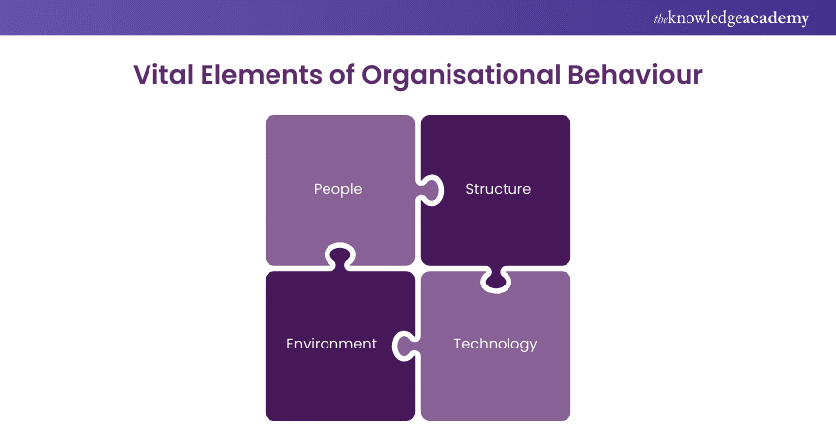
Key Elements of Organizational Behavior

Slide 15
Key Elements of Organizational Behavior
People: People serve as the backbone of any organization, and understanding human behavior is crucial for effective leadership and Business Management.
Structure: The structure of an organization establishes its formal structure and defines the roles, responsibilities, and relationships among its members.
Departmentalization
authority delegation
range of control, and
centralization of decision-making are all included in this structure.
Technology: Businesses take advantage of technological advancements to gain a competitive edge by understanding how they affect behaviour and making suitable changes.
Environment: The organisational environment encompasses internal and external factors impacting behaviour and decision-making.
Internally, it includes culture, values, and policies, while
externally, it involves economic, social, and technical changes. Managers can navigate these dynamics by thoroughly analysing their organisation's environment.

Slide 16
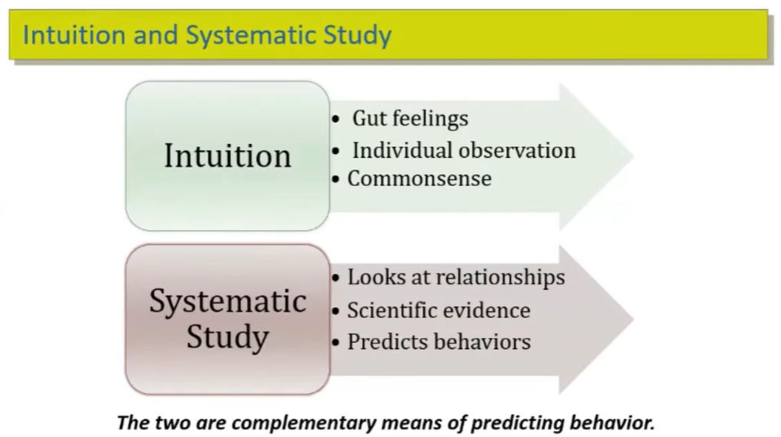
Intuition and Systematic Study in OB

Slide 17
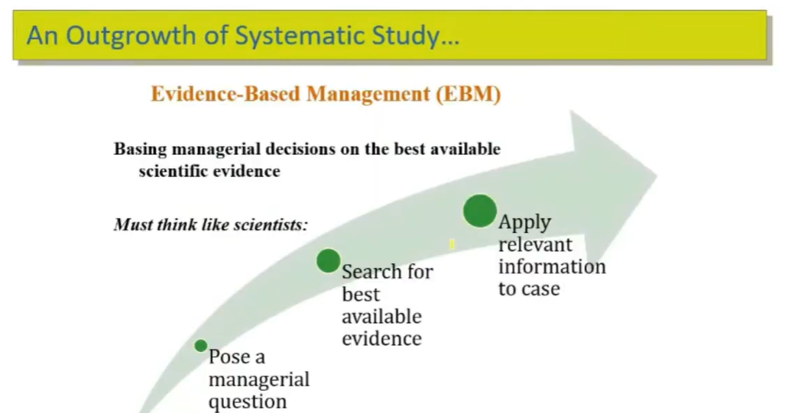
Intuition and Systematic Study in OB

Slide 18
Difference Between Intuition and Systematic Study
Basis | Intuition | Systematic Study
Meaning | Based on personal feelings and experience | Based on research and scientific methods
Accuracy | May be subjective and less reliable | More objective and reliable
Decision-making | Quick and instinctive | Logical and data-based

Slide 19
Challenges for Organisational Behaviour
1. Lack of Clear Direction
2. Integrating Multiple Personalities
3. Development of Key Capabilities and Behaviours
4. Poor Communication and Feedback
5. Absence of Perception
6. Turnover
7. Productivity Issues
8. Limited Innovation
9. Dealing with Workplace Conflicts
10. Clarifying Roles and Responsibilities

